Slide 1
The Implementation of
Social Security Advisors
The National Association of Registered Social Security Analysts, Ltd. has no affiliation with the Social Security Administration or any other government agency. The Social Security information provided, does not, and is not intended to constitute financial advice. All information, content, and materials available are for general informational purposes.

Slide 2


Where to start?

Slide 3
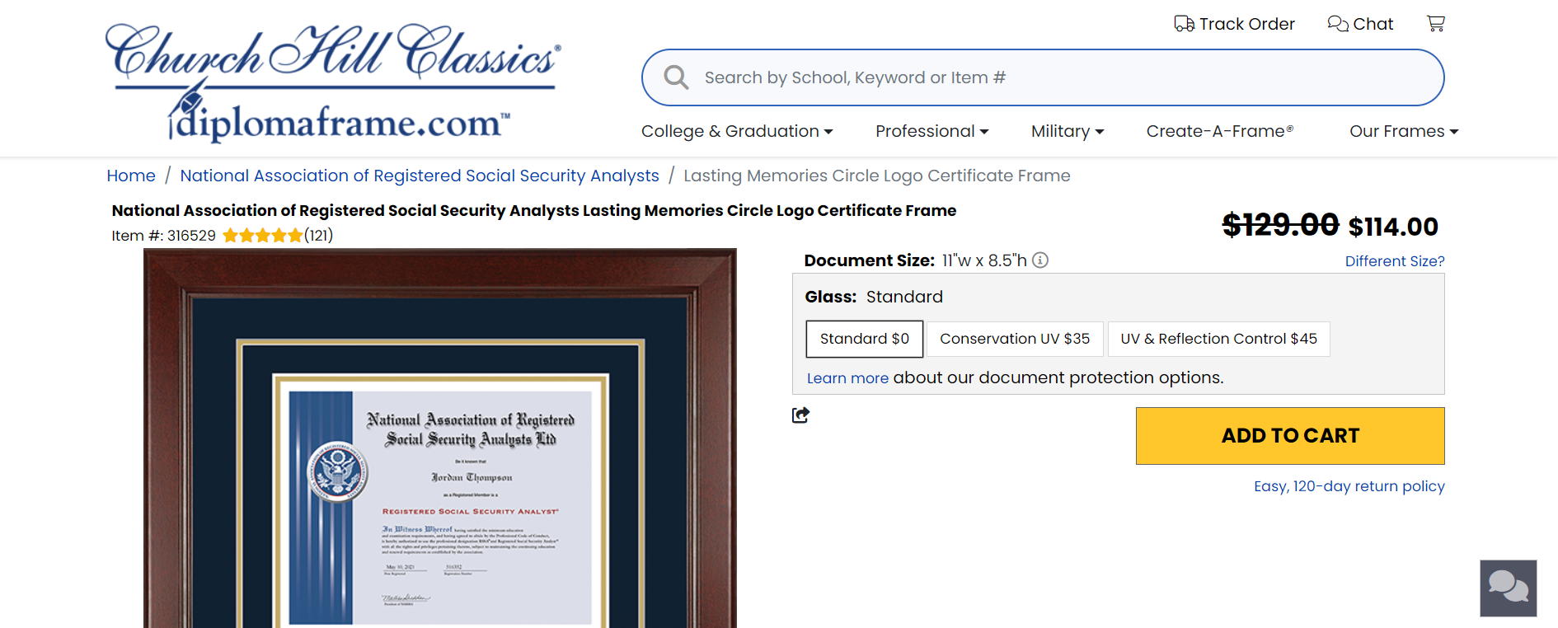
Show off your success

Slide 4

Add Brochures & Business Cards

Slide 5
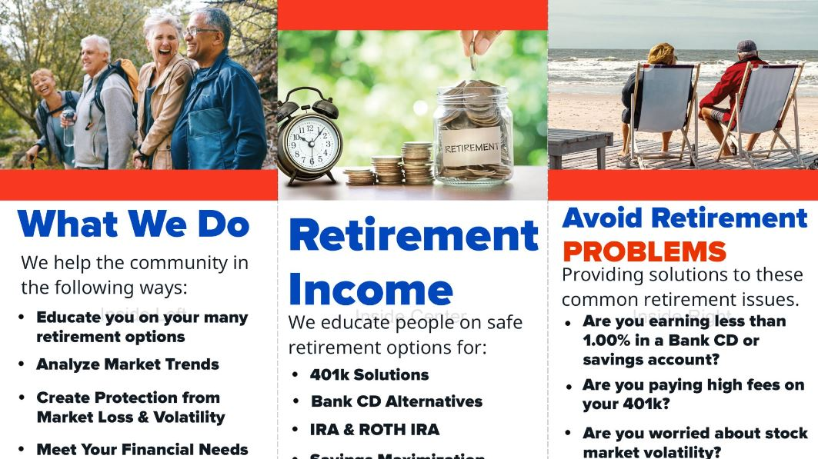

Slide 6
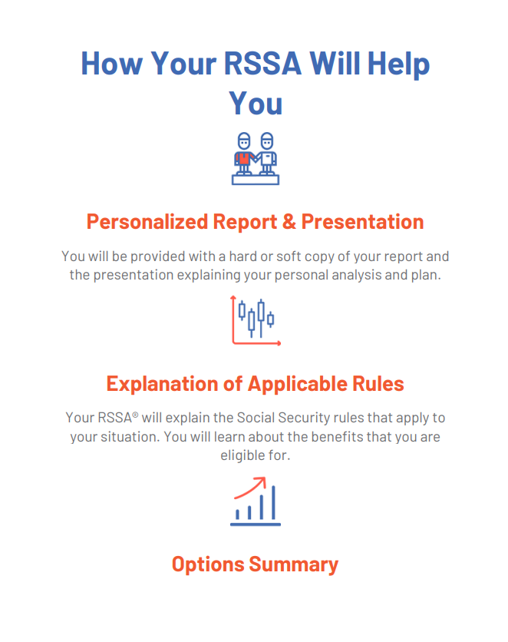
Handouts

Slide 7

Getting started with 10 friendly’s

Slide 8
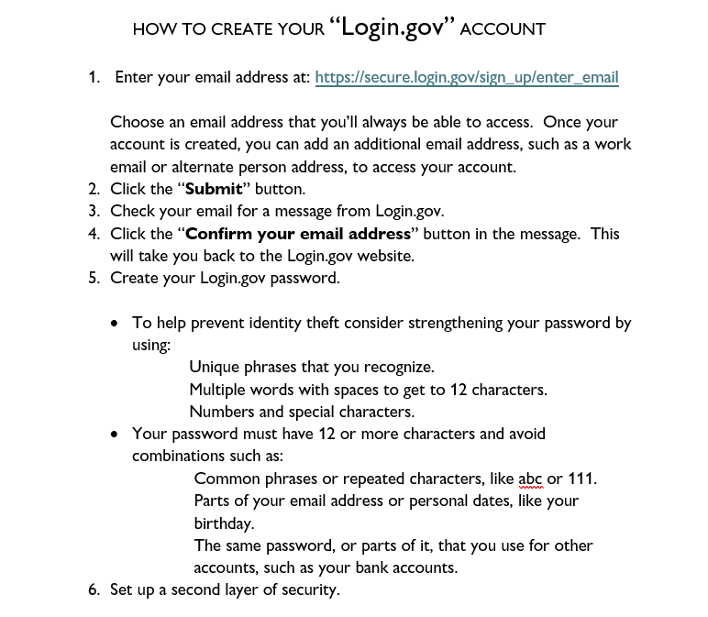
Teach clients how to get their earnings record

Slide 9
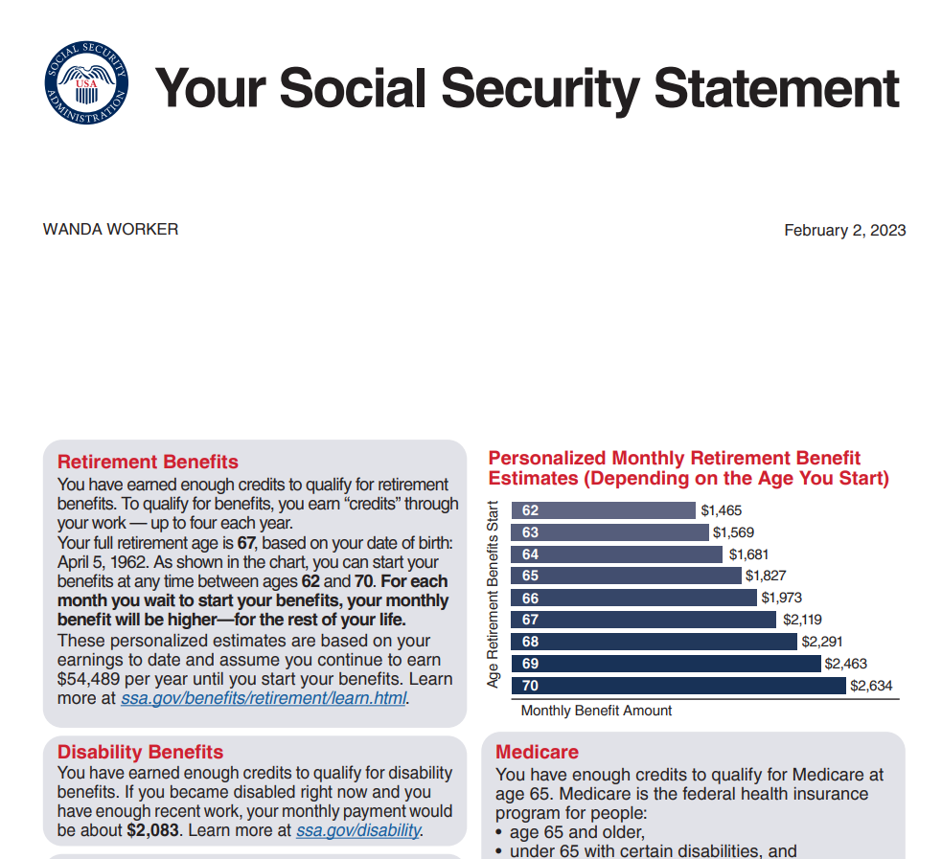

Slide 10
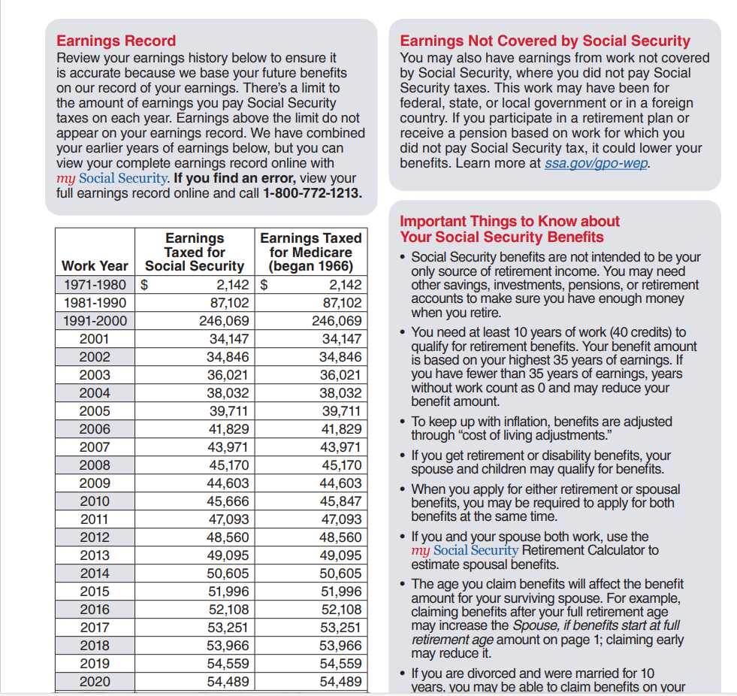

Slide 11
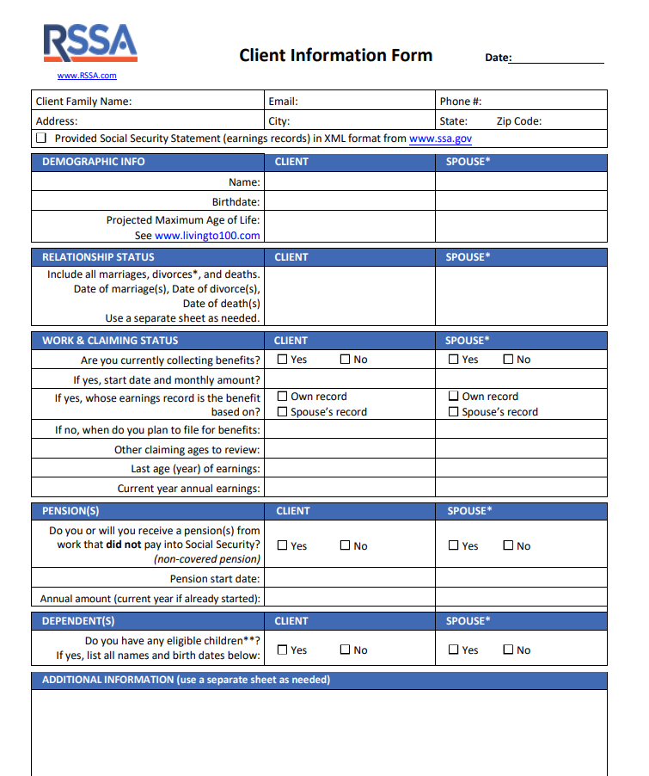
Client form

Slide 12
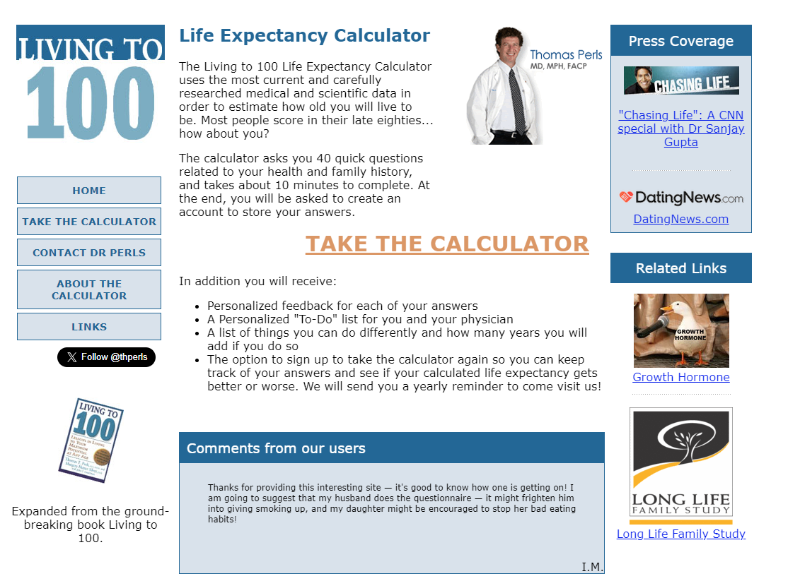
Living to 100 = Life Expectancy

Slide 13
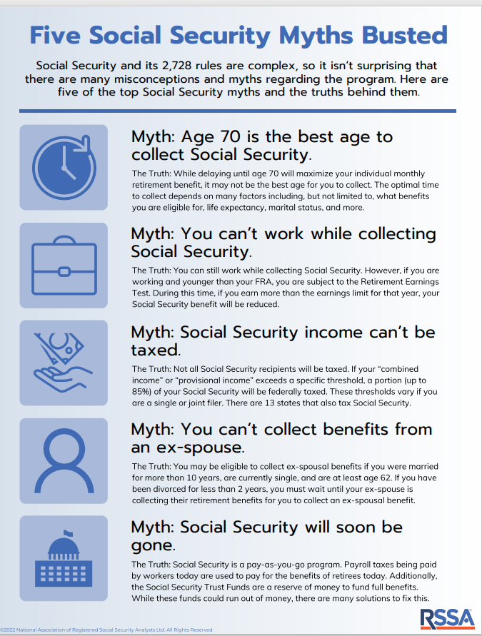
Talking points

Slide 14

Flyers

Slide 15


AMDA

Slide 16
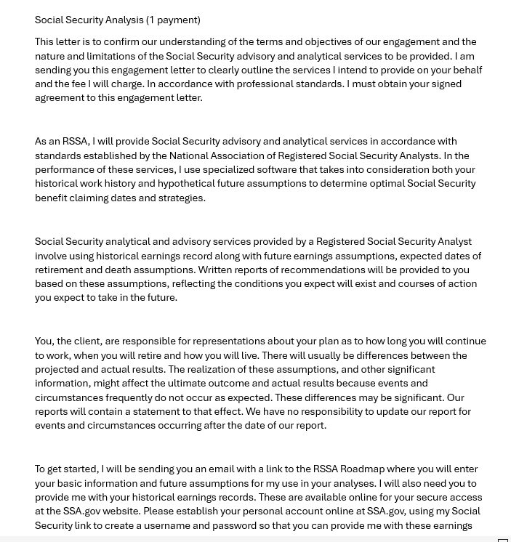
Payment

Slide 17
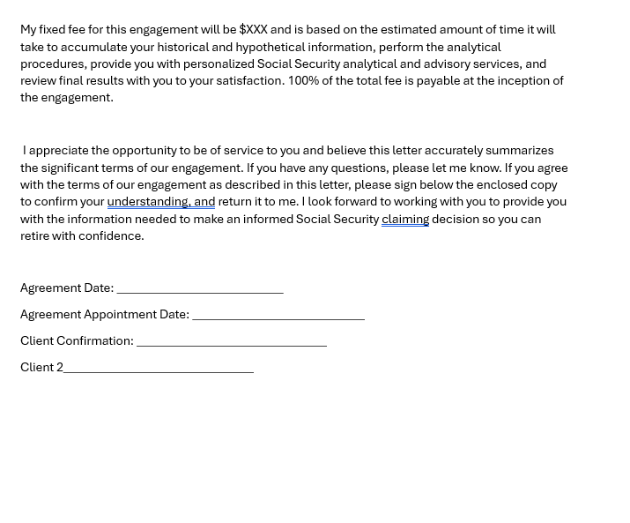
Create an Invoice program

Slide 18
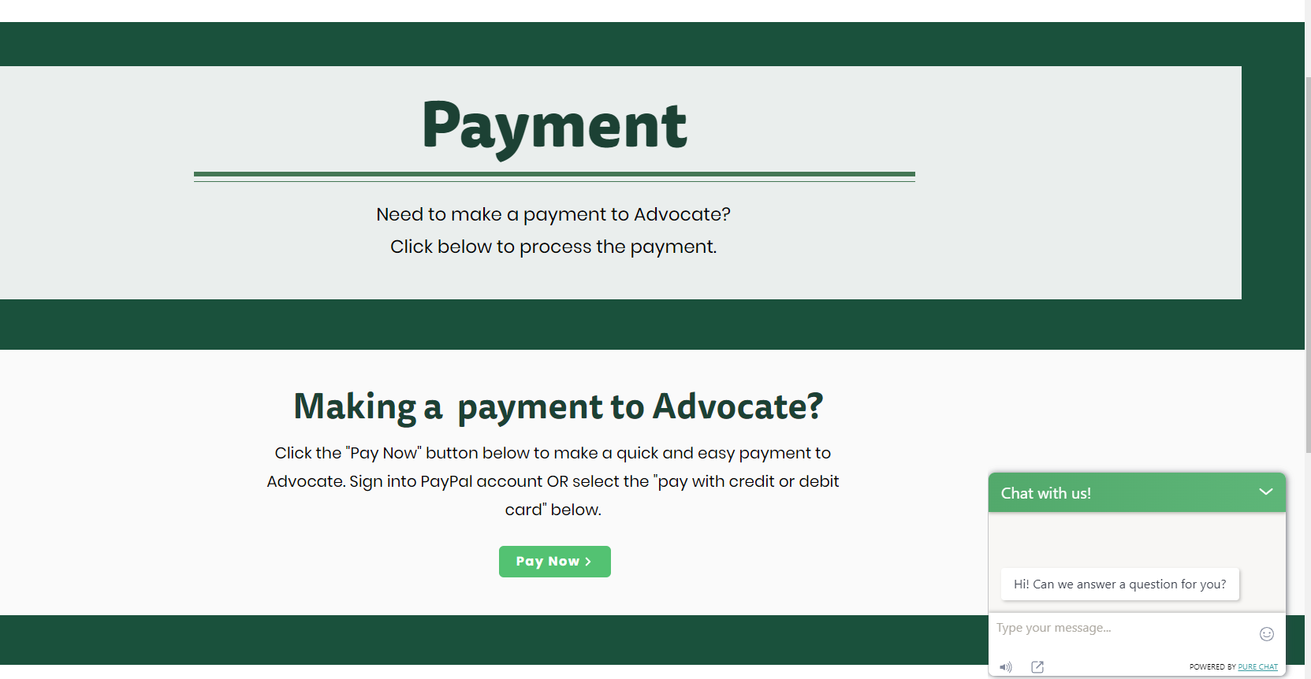

Slide 19
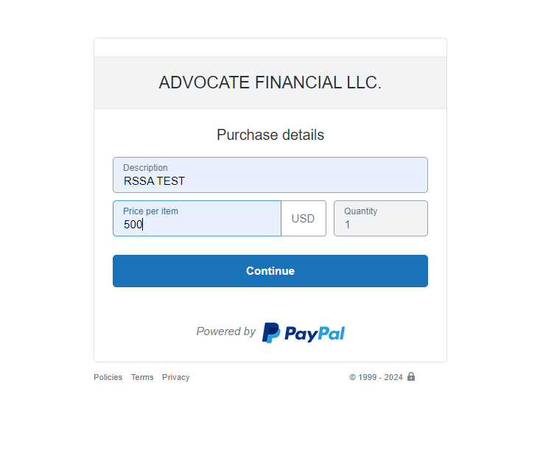
Pay with PayPal

Slide 20
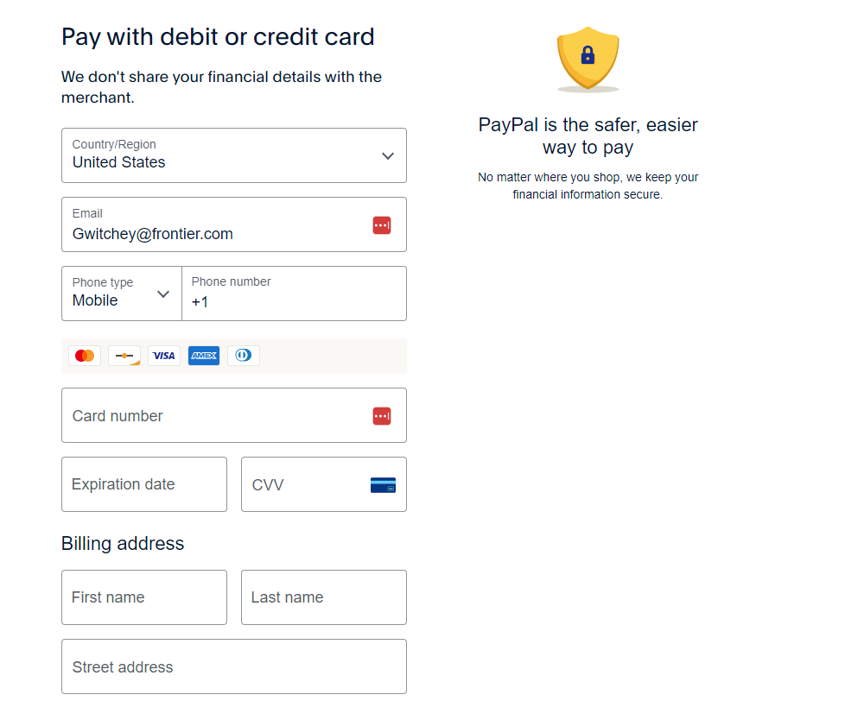
Pay with Credit card

Slide 21

Deliverables

Slide 22

Our Promise
RSSA Deliverables $500
Personalized Social Security Analysis per couple or person
Personalized Social Security Roadmap
  Overview of Children’s Benefits
  SSI
  Survivor Benefits
  Spousal Benefits
  SSDI
Q & A on Options provided
Help with Applying for benefits
Annual Review
Enrolling in safe money if requested

Slide 23
Professional Relationship
CPA’s & Legal Services
Attorney’s
Financial Advisors & Wealth Management
Banks & Credit Unions
Schools
Healthcare
Legal Services
Edward Jones Investment firms
Event centers-Parks Dept, YMCA, Library
Other Medicare Agents
Fraternal Organizations
Churches
Alumni groups
Disability Groups

Slide 24
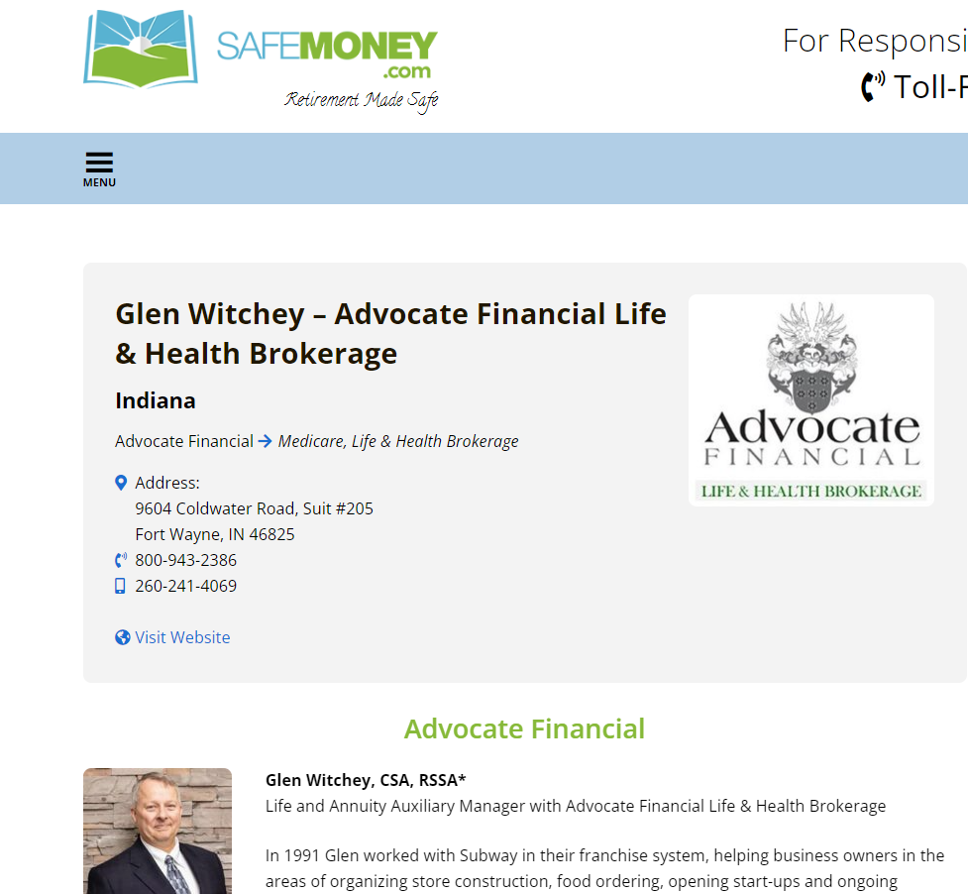
Get on Social Media

Slide 25
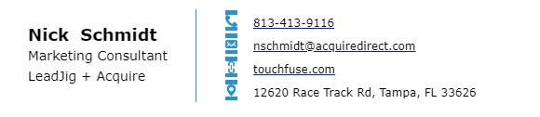
Seminars

Slide 26
Understanding and Optimizing
Social Security Benefits
Presenter’s Name
123-456-7890
johndoe@gmail.com
The National Association of Registered Social Security Analysts, Ltd. has no affiliation with the Social Security Administration or any other government agency. The Social Security information provided, does not, and is not intended to constitute financial advice. All information, content, and materials available are for general informational purposes.
Notes:
Update slides 1 and 24 with your contact information and make any additional changes as needed!
These are not notes to say, but what you as the presenter should discuss in your own words for this slide. The rest of the slides you can use the notes word for word or as a guide for your own way of saying things.
Start by introducing yourself as an RSSA and how your knowledge and experience will help the audience understand and make the best claiming decisions for their personal circumstances.
This may be a good time to use your personality to really draw in the audience and make this more of a workshop. It is always best to present in a friendly and educational manner and not as a salesperson. The cross-selling opportunities will come, but after you have your one-on-one Social Security consultation with the individuals or couples.
How do you get the one-on-one appointments? Go through this presentation and educate the audience on some of the basic rules, complexities, the important things they should know, the pitfalls, etc. and let them know they will be provided with a one-on-one consultation with them.
You can answer questions throughout and at the end, and at the end your call to action would be to set up a one-on-one consultation with you so you can help them with their unique situations by providing them with a personalized Social Security analysis and consultation to review it with them.
This will allow you to answer their questions, help them with their claiming decisions, and build a relationship with you so you have an open door to offer your other services.

Slide 27
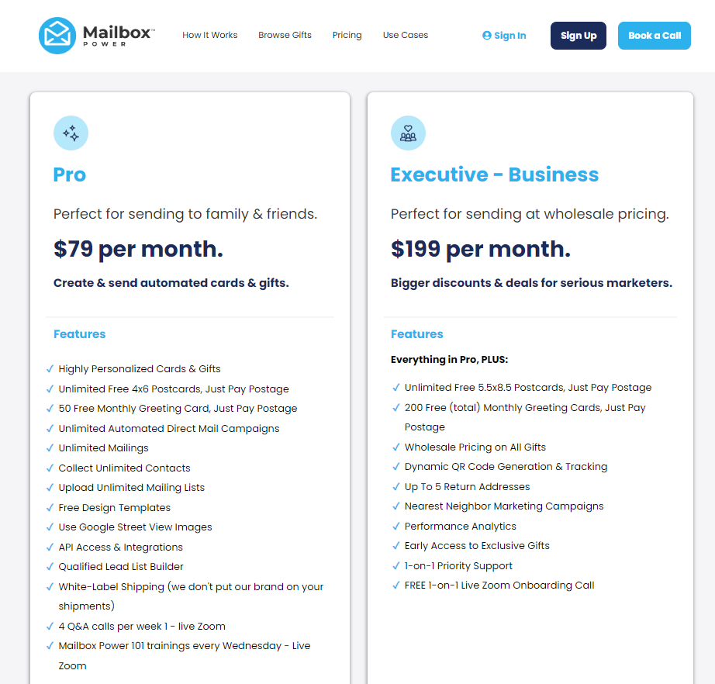
Mailbox Power

Slide 28
Practice the Roadmap and get started

Slide 29

Q & A

Slide 30


